Slide 1

Roles and Processes in Data Analytics

Slide 2
Let’s start with your power point presentations.
I’ll create random break rooms of three students.
This time, you must take a minimum of 4 minutes for your presentation and 2 minutes for Q&A.
Do not start the second or third presentations until I indicate it.
Present all relevant information about the role you choose, statistics and implications in the industry.

Slide 3
Let’s have another in-Class R test
NOT GRADED
This time test is not graded, but you will be rewarded 5 points to any project if you:
Complete satisfactorily at least 3 of the 4 questions given in the R File
Choose the 3 question you feel more comfortable to complete
The tasks will measure your skills to produce bar plots, box plots and scatter plots.
Go to Discussions Section: M5 inCLass R Test (Not graded)
I’ll allow you 5 minutes to open your R project file you created for this class in your computer, and to find your previous R files to use them as references.

Slide 4
Roles and Processes in Data Analytics

Slide 5



Roles
Industries
Skills
Data Scientist
Data Analyst
Data Architect
Data Engineer
Statistician
Data Base Administrator
Business Analyst
Data Analyst Manager
Medicine
Healthcare & Pharmaceutical
Telecommunications Sector
Education
Transportation
Internet Industry
Communications, Media, and Entertainment
Government
Retails:
Energy Sector
Banking and finance
Automotive Industry
Manufacturing and Natural Resources
Structured Query Language (SQL)
Microsoft Excel
Critical thinking
R or Python
Data visualization
Presentation skills
Machine learning
Networking

Slide 6
Data Scientist
Clean, organizes and analyze data (big)
Data Analyst
Collect and perform statistical data analyses
Data Architect
Creates blueprints for data management systems
Data Engineer
Develops, constructs, test and maintains architectures
Statistician
Collects, analyzes and interpret data, applies statistical theories and methods
Data Base Administrator
Manage databases and make sure they are ready and available to all possible users
Business Analyst
Improves business processes , intermediary between business and IT
Data Analyst Manager
Manage teams of analysts and data scientists
Roles

Slide 7
Medicine
Healthcare & Pharmaceutical
Telecommunications Sector
Education
Transportation
Internet Industry
Communications, Media, and Entertainment
Government
Retails
Energy Sector
Banking and finance
Automotive Industry
Manufacturing and Natural Resources
Industries

Slide 8
Skills
R or Python
Advanced Analysis
Predictive Analytics
Data visualization
Excel
Tableau
Presentation skills
Written reports
Oral Presentations
Interactive Dashboards
Machine learning
Artificial intelligence
Predictive analytics
Structured Query Language (SQL)
Database language
Can handle large data sets
Store and manage data
Microsoft Excel
Excellent tool with limitations
Critical thinking
Innate skill that can be improved
Think for yourself, imagine, create, Discover and explain connections that are not clear

Slide 9

Analytics Evolution

Slide 10
The rapid evolution of data analytics has been accelerated by advances in:
Large scale Internet connectivity.
Data warehousing.
Data analysis and mining algorithms development.

Slide 11
Some industries and functional areas.
Online retail industry: forecasting and merchandising.
Financial industry: credit and risk estimates.
Healthcare industry: drug trials.
Telecommunication industry: product subscriptions.
Within each of these industries, data analytics contributes to marketing and sales promotions, customer relationships, and distributions.

Slide 12
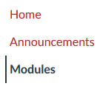
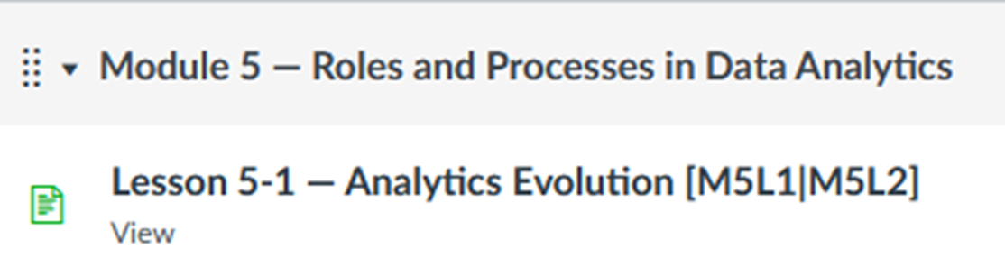
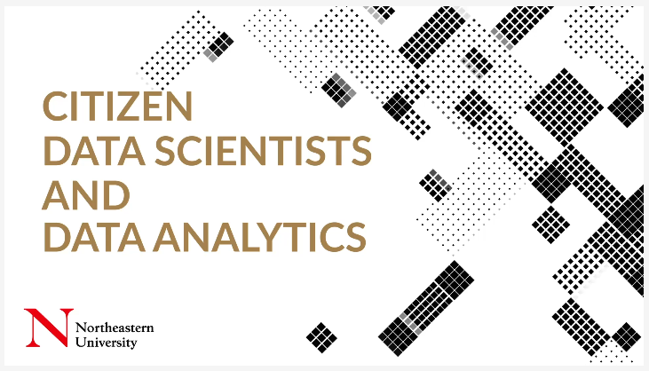
Go to our course CANVAS.
Go to Modules Section
Go to Module 5 – Roles and Processes in Data Analytics
Go to Lesson 5-1 Analytics Evolution
Watch the video: Citizens data scientists and data analytics

Slide 13

Evolution Timeline

Slide 14
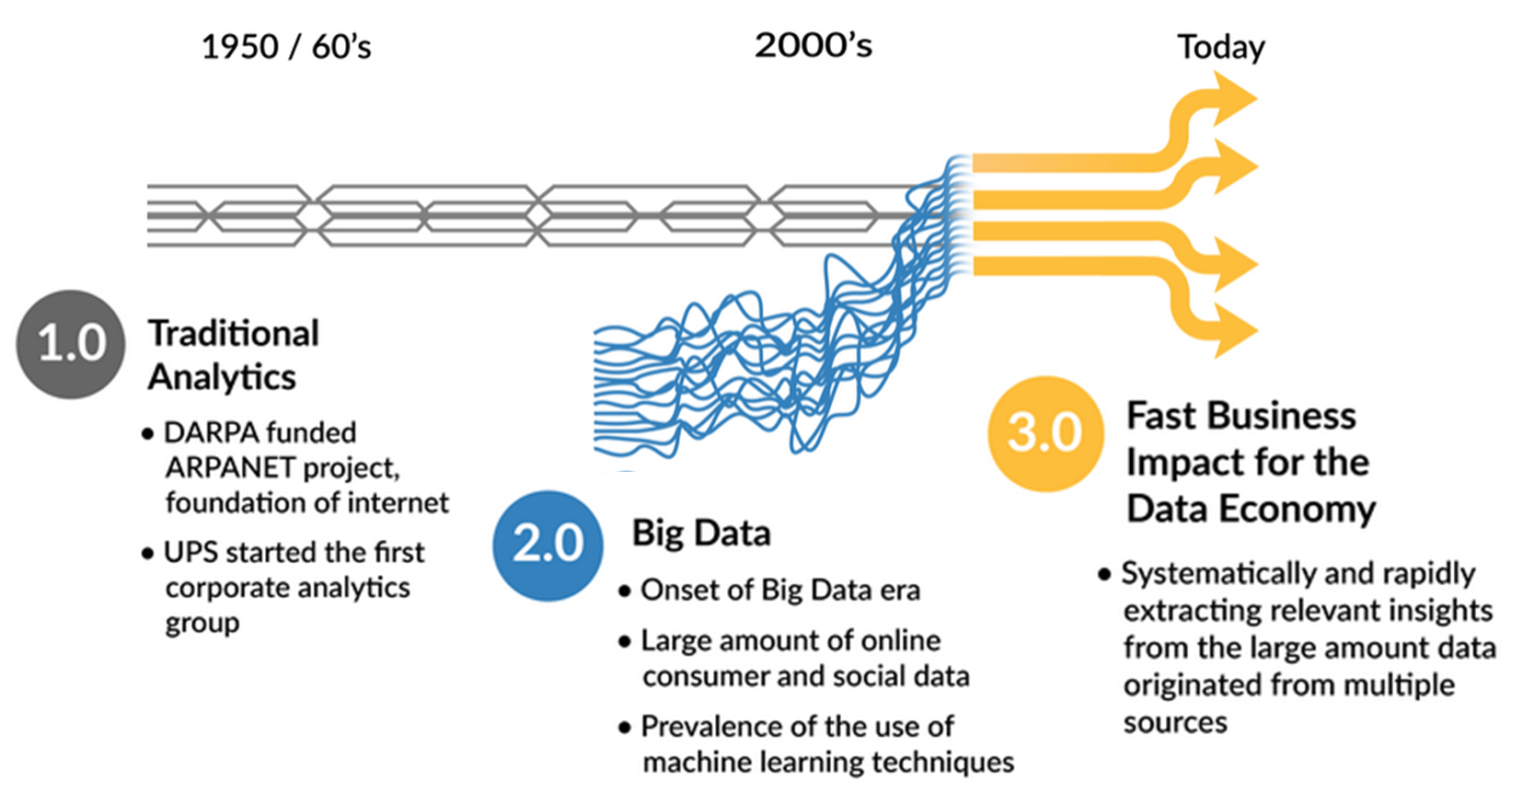

Slide 15
Analytics 1.0 or Traditional Analytics
Relatively small and structured data sets.
Majority (+90%) of analytical activity was descriptive analytics or reporting
Creating analytical models was a time-consuming “batch” process performed on data collected the previous day.
Analytics were marginal to strategy but were available to the decision-making process, still dominated by experience and intuition.
Data small enough in volume to be segregated in separate locations for analysis.
Data warehouses became uncomfortably large because of the number of data sets contained in them.

Slide 16
Analytics 2.0
Constant volume growth of complex, large, and unstructured data sources.
New analytical and computational capabilities.
Emerging of the “Data Scientists” generation.
Fast flow of data necessitated rapid storage and processing = Beginning of large-scale data-based products and services.
“In-memory” analytics and “in-database” analytics employed
Machine learning methods meant the overall speed of analysis was much faster
Visual analytics often crowded out predictive and prescriptive techniques
“Agile is too slow”
“Being a consultant is the dead zone”
Information (and hardware and software) wants to be free
Share your big data tools with the community

Slide 17
Analytics 3.0
Analytics is integral to running a business and an essential aspect of strategic planning.
Trends and analyses instantly obtained for time intervals of interests. = Rapid and agile insight delivery.
Analytical tools available at point of decision
Cultural evolution embeds analytics into decision and operational processes
All businesses can create data-based products and services
"...virtually any type of firm in any industry can participate in the data economy."
A blend of big data and traditional analytics that yields insights and offerings with speed and impact

Slide 18

Analytics Development
“The ladder of sophistication”

Slide 19
The ladder of sophistication in data analytics can be viewed as the sequence of:
Exploratory analysis: Extraction of summary descriptive analytics
Predictive analysis: Capability to forecast based on past information and trends
Prescriptive analysis: Turns information from the previous two steps to provide actionable information.
Optimization: Considers business and data derived constraints to suggest ‘best’ courses of action.

Slide 20
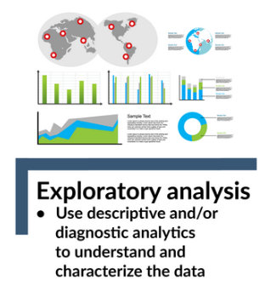
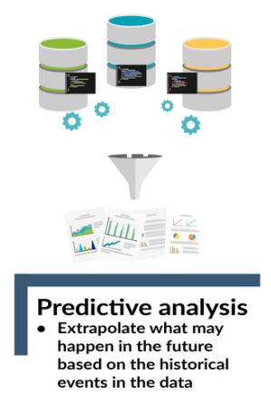
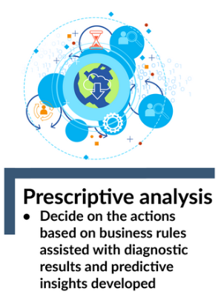
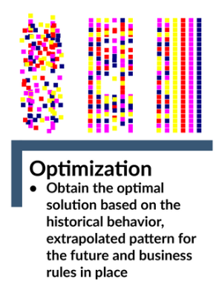

Slide 21
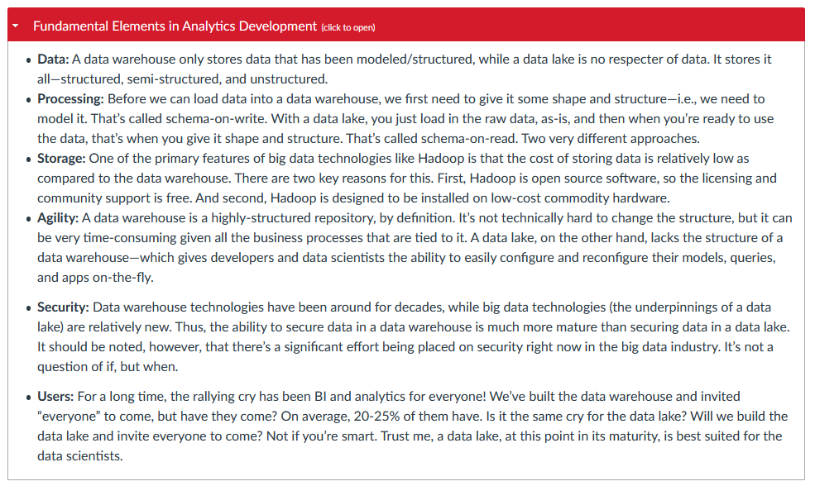

Slide 22

Processes in Data Analytics
“The cyclic pattern”

Slide 23
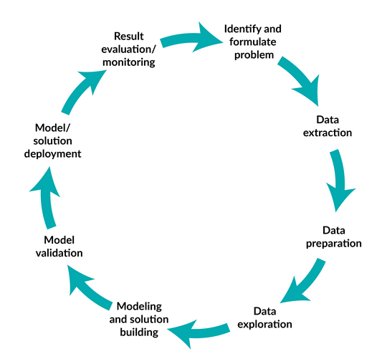

Slide 24
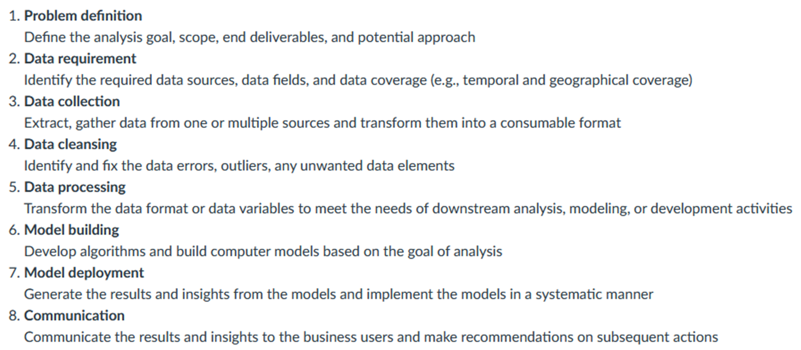
Steps in an Analytics Development Process

Slide 25
Typical challenges and Pitfalls in an Analytics Project
Poorly defined problem.
Limited IT resources.
Less-best approach.
Incomplete, insufficient, or incorrect data.
Original data not accessible.
Insufficient communication

